Slide 1
Team Members ASVK Vinayak Sourav Bera
Gymstructor

Slide 2
Purpose of Gymstructor
During the COVID-19 Pandemic we can see that gyms, yoga centers are closed and we can see how difficult is to manage.
So we have came up with Gymstructor an android app from which users can do excersies, yoga in comfort of their home.
It also helps user by informing users about proper health diet, calculates user’s BMI and tells health status of the user.

Slide 3
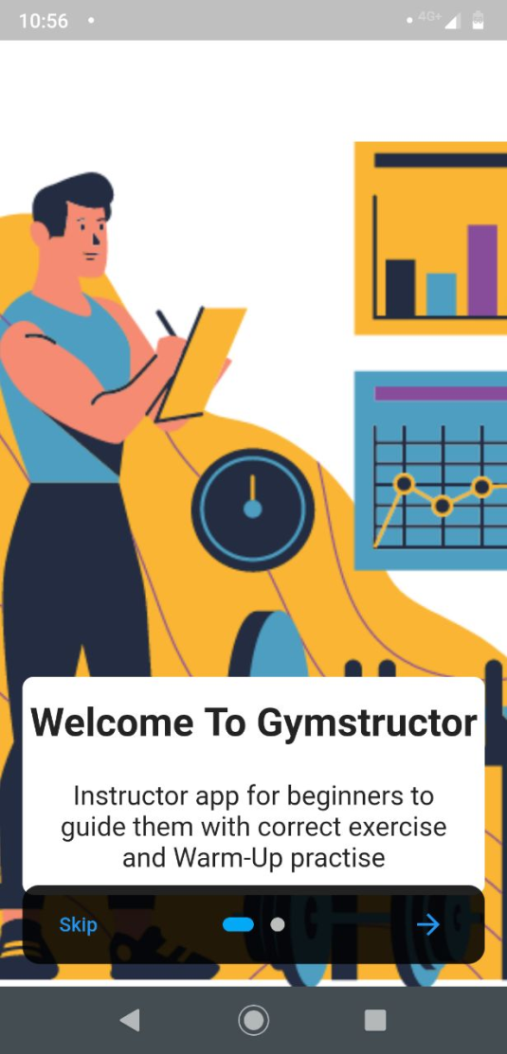
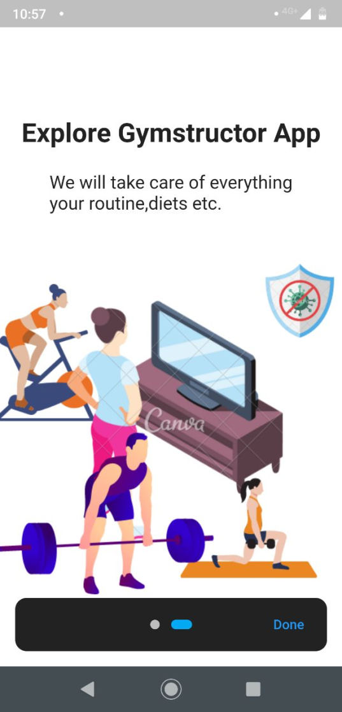
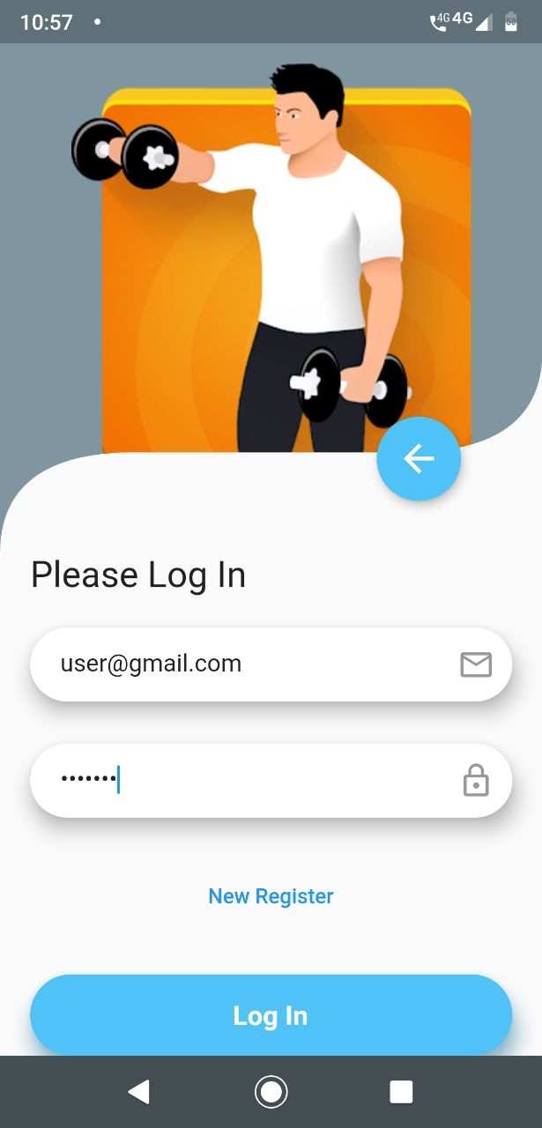
Screenshots

Slide 4
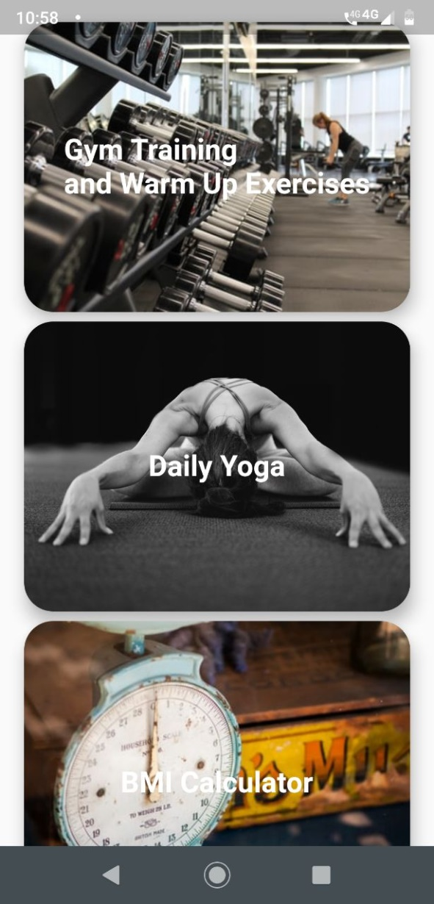
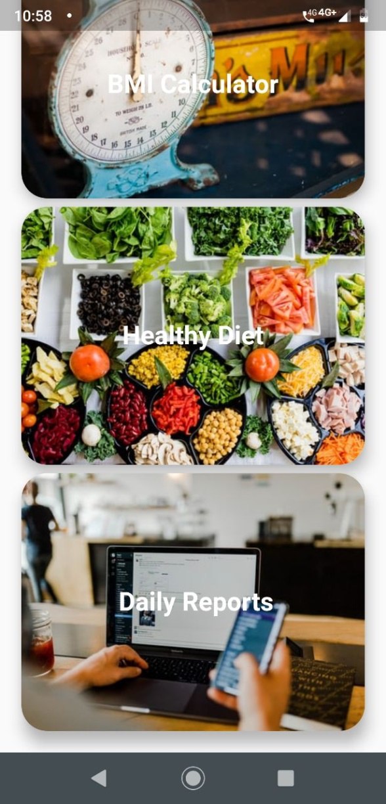
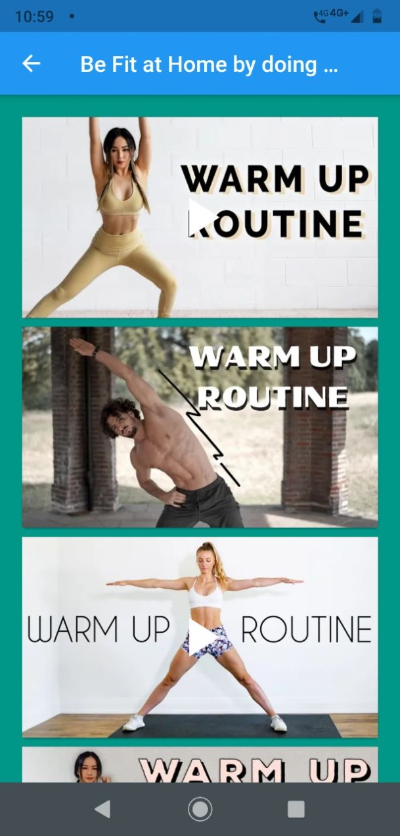
Screenshots

Slide 5
Purpose of Gymstructor
During the COVID-19 Pandemic we can see that gyms, yoga centers are closed and we can feel how difficult is to manage.
So we have came up with Gymstructor an android app from which users can do exercises, yoga in comfort of their home.
It also helps user by telling users about proper health diet, calculates user’s BMI and tells health status of the user.

Slide 6
What users can expect
We are constantly working on making the app more user friendly.
We will enhance the app by making a call section in which users can video contact their gym instructors from home only.

Slide 7
Member’s Individual Contribution
Sourav has made user friendly UI of the app. He has added BMI calculator for users in our app. He also helped while fixing the bugs of our app.
Vinayak has added the video playlist section for yoga , warmup exercises section. He has added Firebase support for our app. He has added the healthy diet section for the users.
Project Link :(https://github.com/ASVKVINAYAK/Gymstructor)

Slide 8
Thank You

